Slide 1
Differential Domain Analysis for
Non-uniform Sampling
Li-Yi Wei Rui Wang
Microsoft Research UMass Amherst
Notes:
This paper is about a new method for analyzing the distribution property of non-uniform stochastic samples.

Slide 2
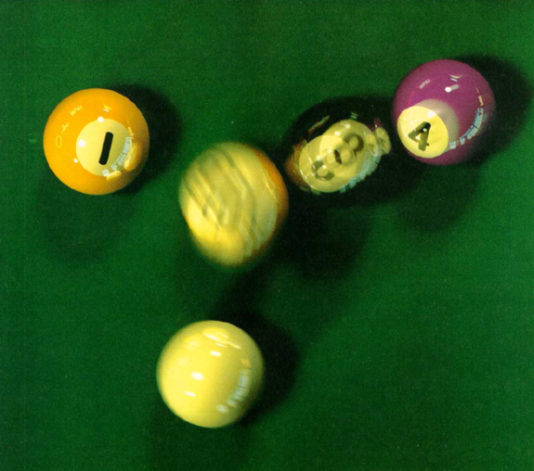
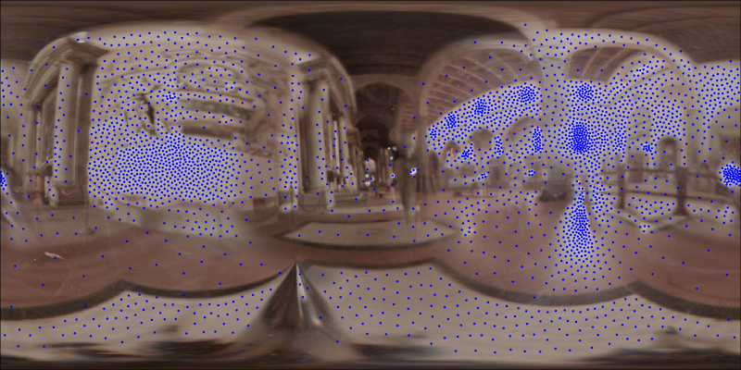
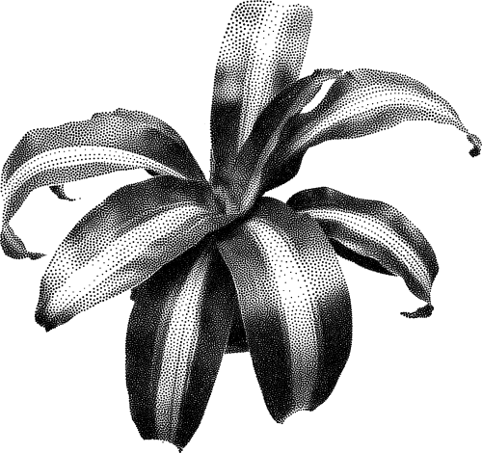
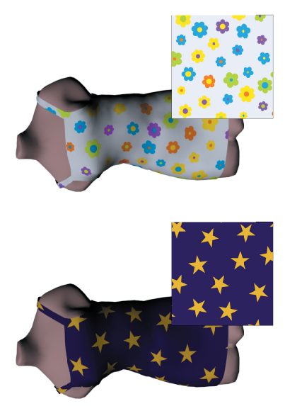
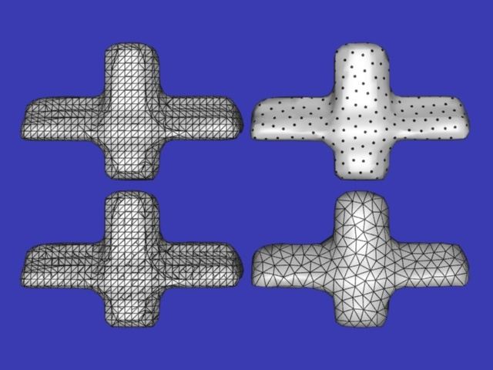
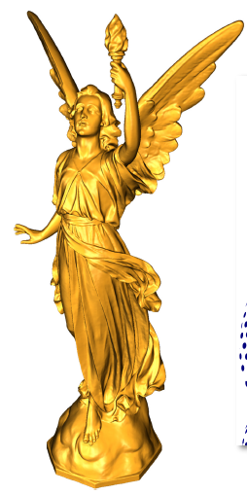
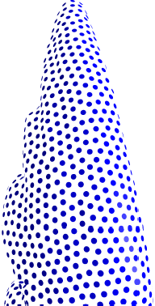
Stochastic Sampling Applications
Ray Tracing
[Cook 1984]
Importance Sampling
[Ostromoukhov et al. 2004]
Halftone and Stippling
[Balzer et al. 2009]
Remeshing
[Turk 1992]
Point-based Modeling
[Öztireli et al. 2010]
Surface Texturing
[Lagae et al. 2005]
Notes:
Stochastic sampling is a fundamental component in many graphics applications. Examples include rendering and imaging applications, such as ray tracing, importance sampling, half tone and stippling, as well as ■ geometry applications, such as remeshing, point-based modeling, and surface texturing. In most of these applications, the distribution property of samples can directly influence the result quality and accuracy. So it must be carefully evaluated.

Slide 3
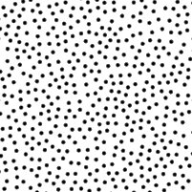
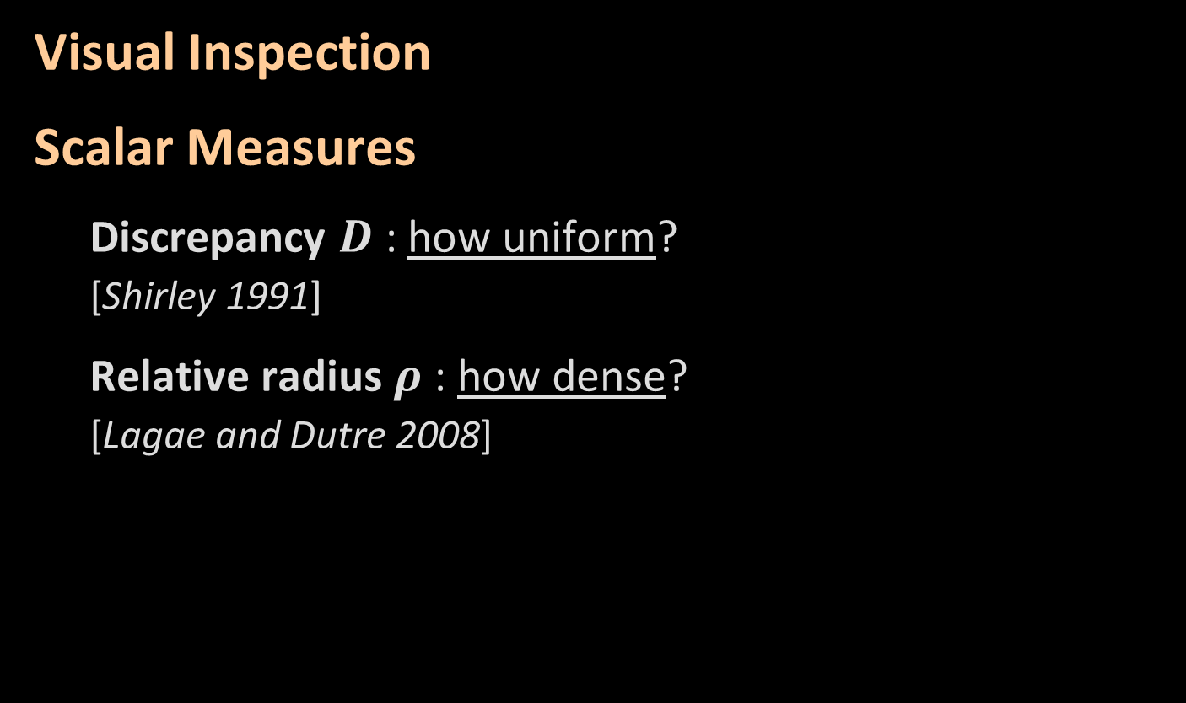
Evaluate Distribution Quality
Samples (spatial)
Visual Inspection
Scalar Measures
  Discrepancy $D$: how uniform?
  [Shirley 1991]
  Relative radius $ρ$ : how dense?
  [Lagae and Dutre 2008]
Notes:
To start, we can visually inspect the samples, but this is too subjective and only suitable for qualitative inspection.
For ■ quantitative inspection, we can compute the discrepancy and the relative radius of the samples. These provide scalar measures to help us understand how uniform or dense the samples are globally.

Slide 4

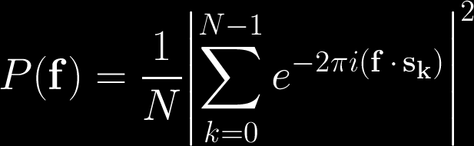
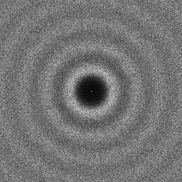
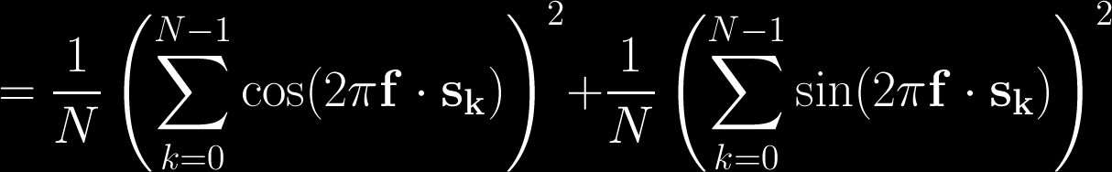

Evaluate Distribution Quality
Samples (spatial)
Fourier spectrum analysis
  [Cook 1986; Ulichney 1987;
  Lagae and Dutre 2008]
Fourier Power Spectrum:
(frequency)
Notes:
However, a more detailed analysis is typically done by inspecting the Fourier power spectrum, ■ which transforms the samples from their spatial domain to the frequency domain. This can be ■ computed by plugging in the sample locations s_k into this equation which measures the squared magnitude of the Fourier transform coefficients. The result can be plotted as a 2D spectrum image shown on the right.
Latex:
P(\mathbf{f})=\frac{1}{N}{\left| \sum_{k=0}^{N-1} e^{-2 \pi i (\mathbf{f} \, \cdot \,\mathbf{s_k})} \right|}^2
=\frac{1}{N}\left( \sum_{k=0}^{N-1} \cos(2 \pi \mathbf{f}\cdot\mathbf{s_k}) \right)^2 + \frac{1}{N}\left( \sum_{k=0}^{N-1} \sin(2 \pi \mathbf{f}\cdot\mathbf{s_k}) \right)^2

Slide 5
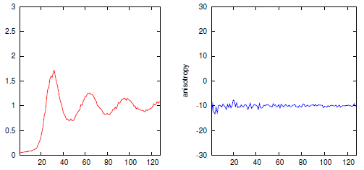
Evaluate Distribution Quality
Samples (spatial)
Fourier spectrum analysis
  Circular average and relative variance
  of the coefficients.
Radial means
Anisotropy
(frequency)
Notes:
From this spectrum image, we can deduce a lot of useful information. For example, we can compute ■ the average and relative variance of the coefficients on each concentric circle. This results in two 1D graphs, which are called the radial means and the anisotropy. Previous work has shown that these graphs are very useful at predicting samples’ behavior for suppressing aliasing artifacts, for improving numerical integration accuracy, and for producing visually pleasing spatial patterns. As a result, Fourier power spectrum has been a widely adopted standard for stochastic sample analysis.

Slide 6
Evaluate Distribution Quality
Fourier spectrum analysis
  The average and relative variance
  of coefficients on each circle (same
  frequency magnitude).
Only available for samples computed with uniform density and in Euclidean space!
Radial means
Anisotropy
Notes:
Unfortunately, this method is only available for samples computed with uniform density and in Euclidean space, because this is where the classic Fourier transform is defined.

Slide 7
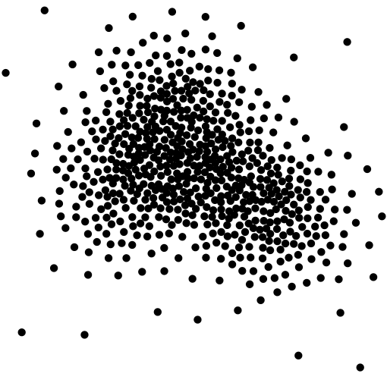
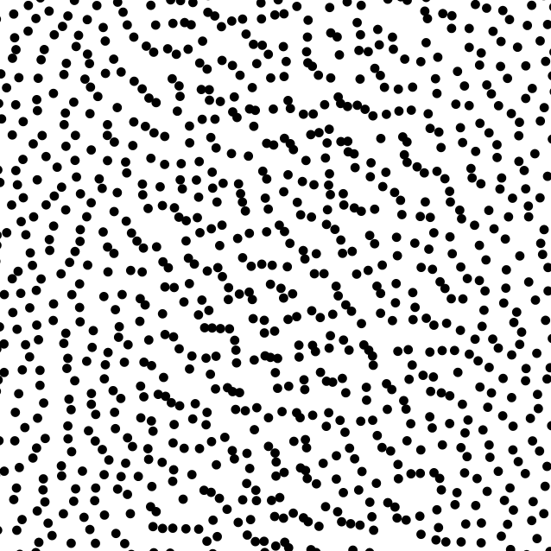
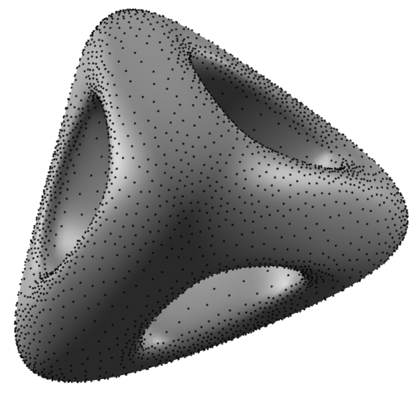
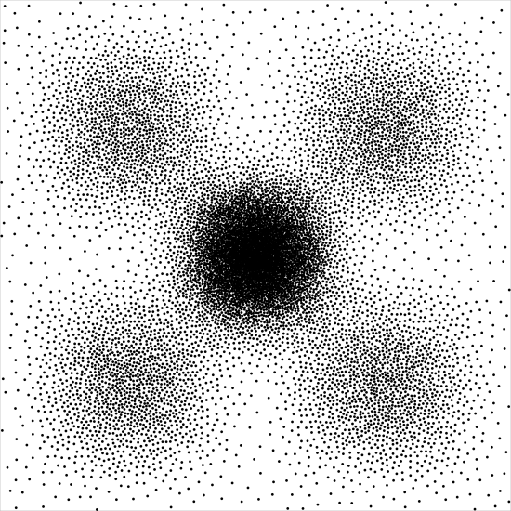
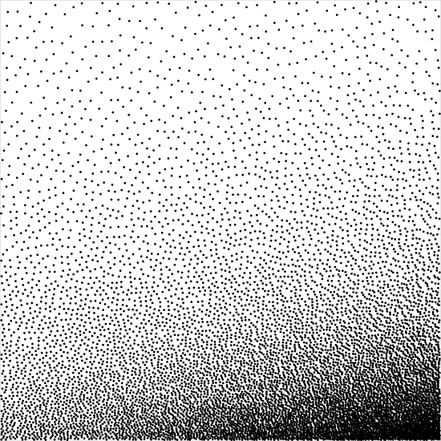
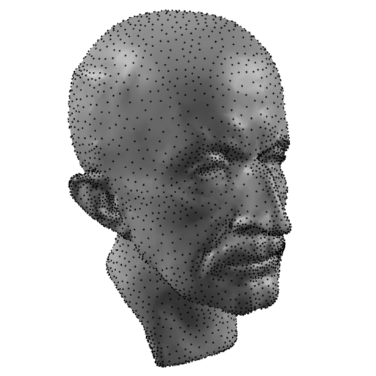
Non-uniform Sampling
Adaptive
Anisotropic
Surface (geodesic)
Notes:
But there are lots of applications, such as adaptive, anisotropic, and surface samplings, where the samples must be computed with non-uniform density or in non-Euclidean spaces. In order to extend classic Fourier analysis to these cases, we would have to define and numerically compute a special Fourier basis for each case. This is a highly non-trivial task, and even when it could be done, it would be expensive and numerically unstable.

Slide 8
Our Contribution
A new method for analyzing non-uniform samples, which we call differential domain analysis.
– Reformulation of Fourier power spectrum.
– Direct computation of samples’ local spatial statistics, without using a Fourier (spectral) basis.
– Generalization, validation, and applications.
Notes:
Our main contribution in this paper is a new method for analyzing non-uniform samples. We call this method the differential domain analysis. It is based on a reformulation of the Fourier power spectrum, and involves only computing the samples’ local spatial statistics. It produces results equivalent to Fourier power spectrum, but without using a Fourier basis. Therefore we can easily generalize this method to non-uniform domains, as well as providing high computation efficiency.

Slide 9
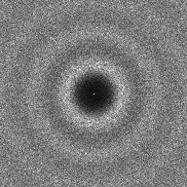
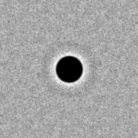
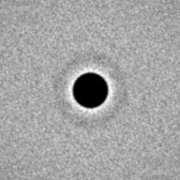
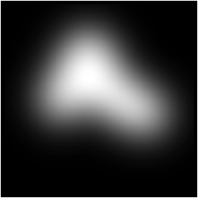
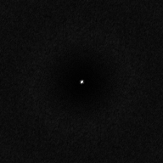
Our Contribution
Sample set
Fourier analysis
Our method
Uniform
Adaptive
Notes:
Here is an example that shows the ability of our method. First, given a uniform sample set, we can apply classic Fourier analysis, and the spectrum image tells us that the samples have a blue noise distribution. However, if ■ the samples are non-uniform, such as computed from a spatially varying density function, the Fourier analysis will produce nothing meaningful, because each sample’s local distance metric is different. In contrast, ■ our method can successfully account for the spatially varying density, and reveals that the two sample sets have similar blue noise distribution.

Slide 10


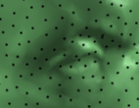
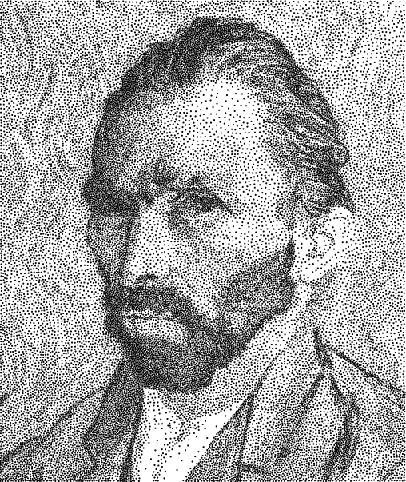
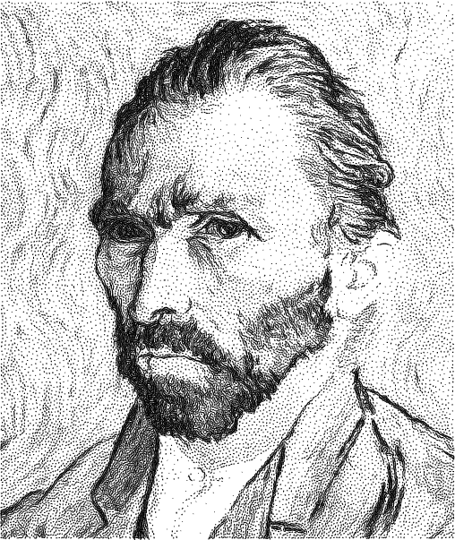
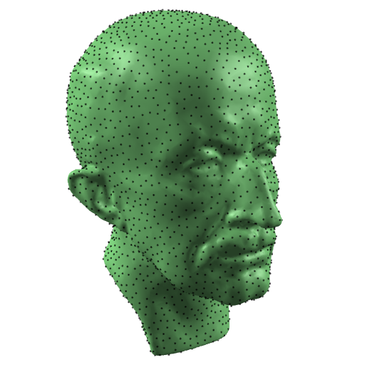
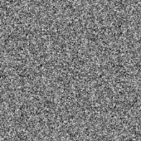
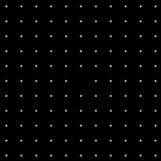
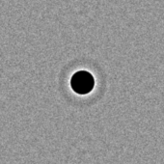
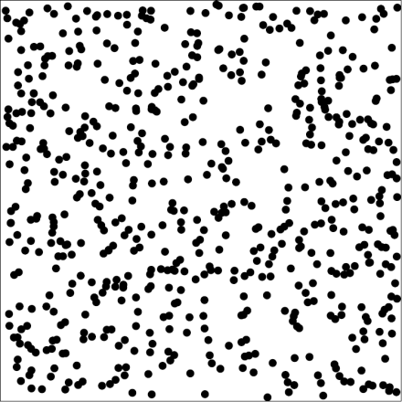

Our Contribution
. . .
Non-uniform
Type
adaptive
anisotropic
surface sampling
Distribution
Property
. . .
white noise
regular grid
blue noise
Notes:
Using this method, we are able to analyze a variety of different non-uniform sampling types, including adaptive, anisotropic, surface, or a combination of them. ■ Our results can be used to capture and infer the samples’ intrinsic distribution properties, whether they are white noise, regular grid, blue noise, or any other type.
4:30 here

Slide 11
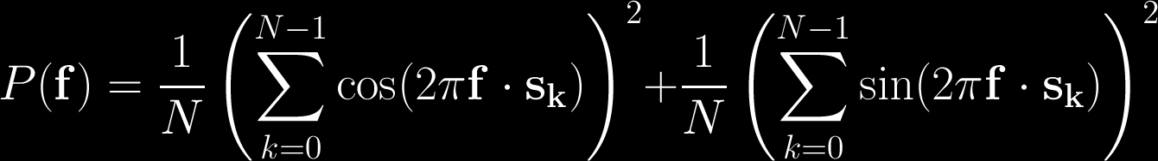
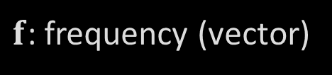
Key Idea
Fourier power spectrum
$f$: frequency (vector)
Notes:
Now let me briefly explain the key idea behind our method. To start, let’s assume a set of samples s_k are computed on the 2D plane. Their Fourier power spectrum ■ is defined by this equation where f is a vector frequency.
Latex:
P(\mathbf{f})=\frac{1}{N}\left( \sum_{k=0}^{N-1} \cos(2 \pi \mathbf{f}\cdot\mathbf{s_k}) \right)^2 + \frac{1}{N}\left( \sum_{k=0}^{N-1} \sin(2 \pi \mathbf{f}\cdot\mathbf{s_k}) \right)^2

Slide 12
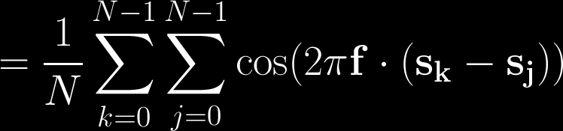

Key Idea
$$d$$
Fourier power spectrum
diff.
Notes:
By using basic trigonometry, we can convert this equation into a simpler form that only relies on the difference between every two samples. We call this the differential vector d.
Latex:
P(\mathbf{f})=\left( \sum_{k=0}^{N-1} \cos(2 \pi \mathbf{f}\cdot\mathbf{x_k}) \right)^2 + \left( \sum_{k=0}^{N-1} \sin(2 \pi \mathbf{f}\cdot\mathbf{x_k}) \right)^2
=\frac{1}{N}\sum_{k=0}^{N-1} \sum_{j=0}^{N-1} \cos ( 2 \pi \mathbf{f} \cdot (\mathbf{s_k}-\mathbf{s_j}) )

Slide 13
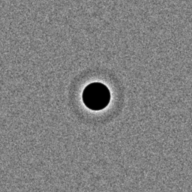
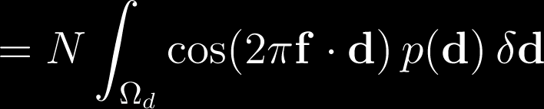
Key Idea
$$d$$
Fourier power spectrum
diff.
diff. distribution
Notes:
Since the equation sums over all such differential vectors, instead of going through every pair of samples individually to compute the summation, we can first construct a histogram of these differential vectors, and then ■ convert the summation into an integration form, where p(d) represents the histogram. Simply speaking, it counts how many pairs of samples are separated by any specific differential vector d, and ■ can be plotted out as a distribution function shown here.
=N \int_{{\Omega}_d}\cos(2\pi\mathbf{f} \cdot \mathbf{d}) \, p(\mathbf{d}) \, \delta \mathbf{d}

Slide 14

Key Idea
Fourier power spectrum
Hello, neighbor?
Standing at a typical point, what’s
the likelihood of nearby samples?
diff.
$$d$$
diff. distribution
Notes:
We can also understand this function as a quantity that tells us by standing at a typical point in this sample set, what’s the likelihood of its nearby samples; in other words, ■ what’s the probability that a sample can be found at any location in its nearby space.

Slide 15


Key Idea
Fourier power spectrum is the cosine
transform of the diff. distribution $p\left(d\right)$.
diff. distribution
Notes:
The significance of this function p(d) is that it completely determines the Fourier power spectrum. Now, from the equation that the Fourier power spectrum is simply a cosine transform of p(d). Therefore, a direct inspection of p(d) is ■ sufficient to infer everything about the power spectrum. This is the key to extend our method to non-uniform samples, without relying on a Fourier basis.

Slide 16
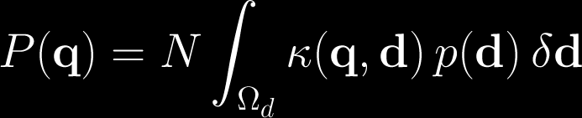
Extension
Generalize the equation using a different transformation kernel.
cosine kernel
diff. distribution
Notes:
In addition, we can generalize this equation by using a different transformation kernel. This leads to a more general concept of power spectrum. For example, we can replace the cosine kernel, which has infinite support
P(\mathbf{q})=N \int_{{\Omega}_d} \kappa(\mathbf{q},\mathbf{d}) \, p(\mathbf{d}) \, \delta \mathbf{d}

Slide 17
Extension
Generalize the equation using a different transformation kernel.
(kernel density
estimation)
Gaussian kernel
diff. distribution
Notes:
with a compact Gaussian kernel. This can be viewed as a kernel density estimation of p(d), which is what we have applied for generating all results in the paper.

Slide 18
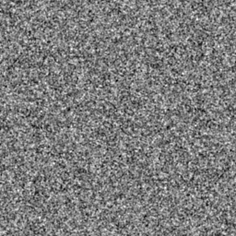
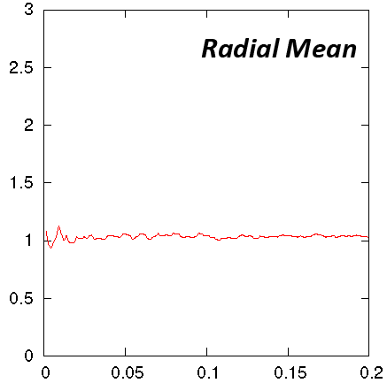
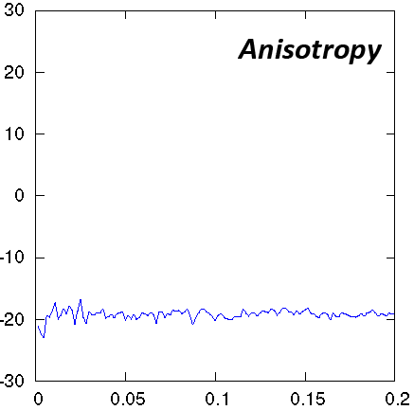
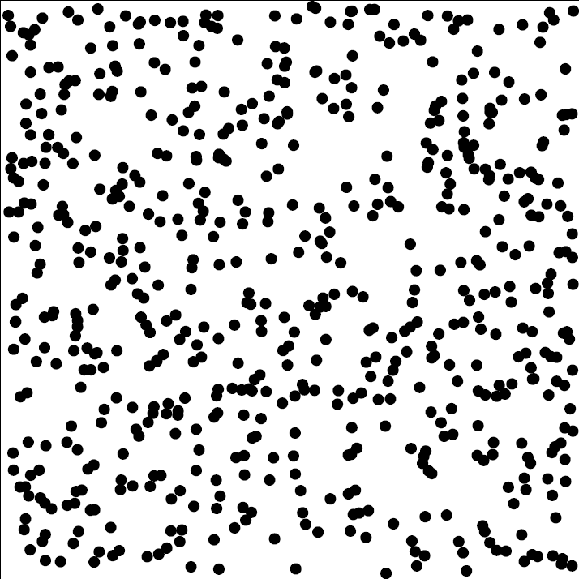
Example: White Noise
P(d)
Radial Means
Anisotropy
Diff.
← sample set
Notes:
Now let’s see how our method works. Given a sample set with unspecified property, we first compute its differential distribution p(d); then as before, we compute the circular average and relative variance, and this results in the radial means and anisotropy graphs. In this case, both graphs are flat, indicating that the samples are uncorrelated and equally distributed everywhere and in every direction, so we conclude that this a ■ white noise sample set.

Slide 19
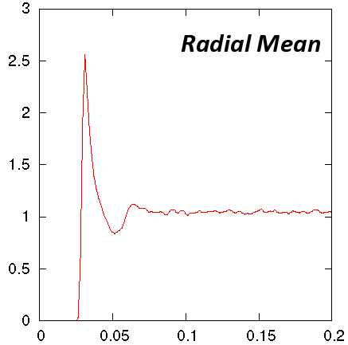
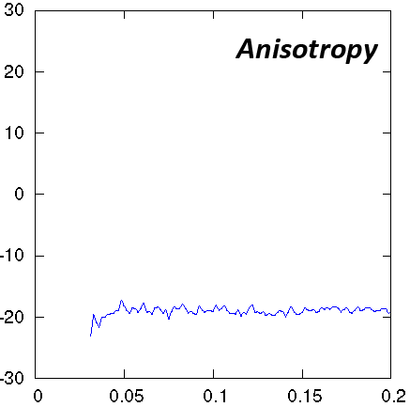
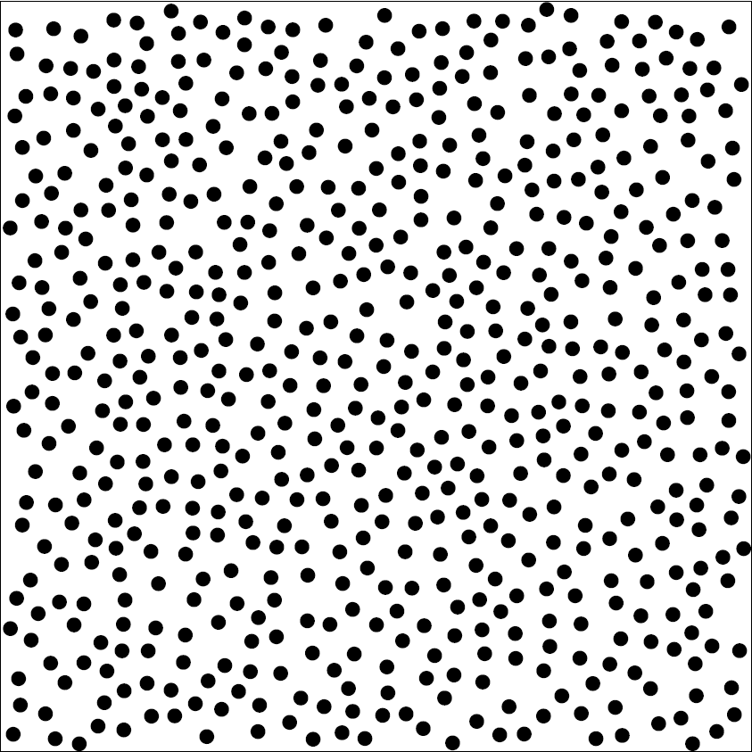

Example: Poisson Disk Samples
P(d)
Radial Means
Anisotropy
peak
Diff.
$r_{min}$ (minimum distance)
← maximal Poisson disk sample set
Notes:
In this second example, we computed p(d) for a maximal Poisson disk sample set. Note that in the radial means graph, there is a very sharp peak right around the minimum sample distance rmin. This indicates that the samples are densely packed under the minimum distance constraint.

Slide 20

Example: Poisson Disk Samples
P(d)
Radial Means
Anisotropy
peak
uncorrelated
(white noise)
Diff.
$${3∙r}_{min}$$
← Poisson disk sample set
Notes:
Also, notice that beyond 3 times rmin, the graph is essentially flat, indicating that samples beyond this distance are uncorrelated and appear as white noise to each other. Therefore, the interesting features about this sample set are all localized within a small range from 0 to 3rmin.

Slide 21
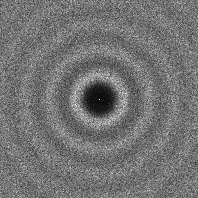
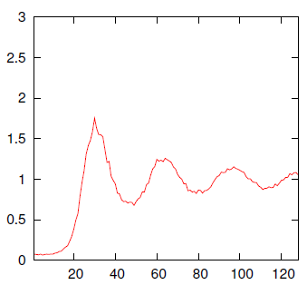
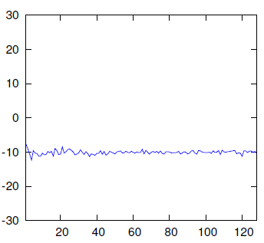
Example: Poisson Disk Samples
P(d)
Radial Means
Anisotropy
peak
uncorrelated
(white noise)
Diff.
P(f)
Radial Means
Anisotropy
Fourier
Notes:
For the purpose of comparison, I also provided the Fourier analysis results here. As I said before, the Fourier power spectrum is simply a cosine transform of P(d). So you can the features in p(d), such as the high peak, directly lead to the features in the Fourier analysis results.

Slide 22
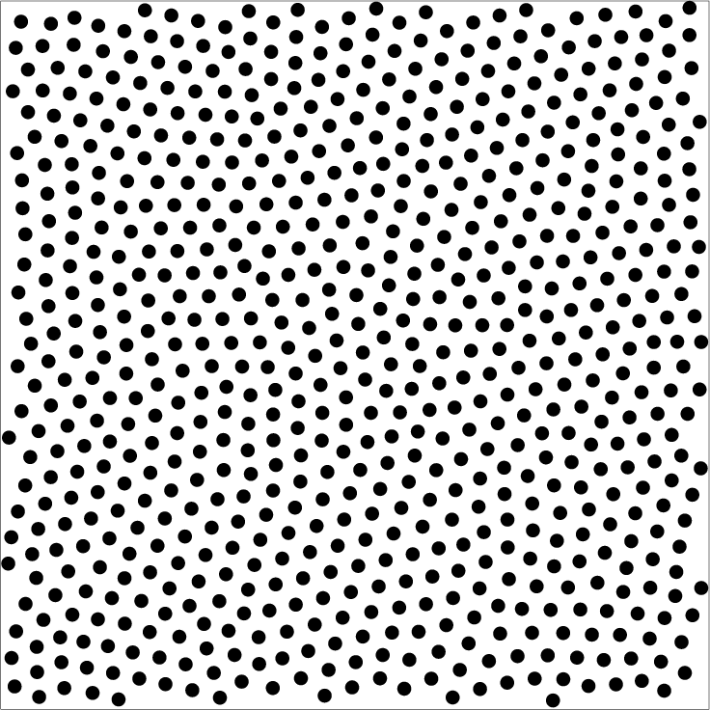











Regular
square grid
Lloyd
relaxation
CCVT
[Balzer 09]
Polyominoes
[Ostromoukhov 07]
Sample
set
Fourier
Diff.
Notes:
We have also analyzed a variety of other common sampling methods. These results can be found in the paper.

Slide 23
Radial Measures
P(d)
Diff.
Normalize analysis results, allowing for comparisons between different experiments.
Notes:
Finally, we have derived analytic radial measures to normalize our analysis results. This makes it possible to draw direct comparisons between experiments running with different settings and parameters. Details can be found in the paper.

Slide 24
Related Work in Spatial Statistics
Auto-correlation function
[Dale et al. 2002; Bonetti and Pagano 2005]
Wiener-Khinchin theorem
[Couch 2001]
Ripley’s K function
[Ripley 1977]
Second moment measure
[Lau et al. 2003]
Notes:
I should note here that our basic idea is fundamentally connected to several well-known concepts in the spatial statistics literature, particularly the autocorrelation function. Despite these connections, our novelty is in generalizing the basic idea beyond uniform sampling domains, and presenting a convenient tool for analyzing non-uniform samples.
With this, I will give the podium to liyi, and he will continue with the rest of the talk.

Slide 25


Sampling
Draw representations of a domain

Slide 26


Slide 27

☺
☺
☺
☺
☺
☹
☺
☺
☺
uniform
☺
☺
☺
☺
☹
☺
☺
☺
☺
☺
☺
☺
☺
☺
☺
non-uniform
☺
☺
☺
☺
☺
☺
spatial samples
Fourier domain
diff domain
(our method)
Notes:
Fourier spectrum is commonly used to analyze sample distributions.
However, it only works for uniform sample domains. If the domain is non-uniform, Fourier analysis won’t produce meaningful results.
We present a differential domain analysis that works non-uniform distributions.
And show you the intrinsic properties, such as the blue noise spectrum here.

Slide 28

Different methods
white noise
regular grid
jittered grid
Lloyd relaxation
CCVT
Polyomino
Notes:
We can analyze different sampling methods with different characteristics

Slide 29



Different domains
adaptive
anisotropic
non-Euclidean
Notes:
As well as different sample domains, including adaptive, anisotropic, and non-Euclidean domains.

Slide 30

Texturing [Wei 2010]

Slide 31


Evaluation
Visual inspection
Spatial analysis
  Discrepancy [Shirley 1991]
  $ρ$ [Lagae and Dutre 2008]
  Distribution [Dale et al. 2002]
Fourier spectrum analysis
  [Ulichney 1987]
Uniform domains!

Slide 32



Non-uniform distribution

Slide 33



Slide 34
Key Idea
Fourier power spectrum
$f$: frequency (vector)
Notes:
Latex:
P(\mathbf{f})=\frac{1}{N}\left( \sum_{k=0}^{N-1} \cos(2 \pi \mathbf{f}\cdot\mathbf{s_k}) \right)^2 + \frac{1}{N}\left( \sum_{k=0}^{N-1} \sin(2 \pi \mathbf{f}\cdot\mathbf{s_k}) \right)^2
=\sum_{k=0}^{N-1} \sum_{j=0}^{N-1} \cos ( 2 \pi \mathbf{f} \cdot (\mathbf{x_k}-\mathbf{x_j}) )

Slide 35
Li-Yi

Slide 36

Differential domain
d
Ω_{d}
Ω

Slide 37

Range selection
d
Ω_{d}
Ω

Slide 38

Non-uniform domain
d
Ω_{d}
Ω

Slide 39

Non-uniform domain
χ(s, s', d)
d
s
s'
warp
Ω_{d}
Ω

Slide 40




Slide 41
Warp
global warp s
[Li et al. 2010]
local warp d
χ(s, s', d)
χ(s, s', d)
Notes:
Li-Yi: need to improve this one

Slide 42

P(q)
p(d)
ξ(d)
χ(s, s', d)
κ
s - s'
Notes:
http://codecogs.com/latex/eqneditor.php
P(\mathbf{q}) = N \int_{\Omega_d} \kappa (\mathbf{q},\mathbf{d}) \, p(\mathbf{d}) \, \delta \mathbf{d}
P(\mathbf{q}) = N \int_{\Omega_d} \kappa (\mathbf{q},\mathbf{d}) \, p(\mathbf{d}) \, \xi(\mathbf{d}) \, \delta \mathbf{d}
P(\mathbf{q}) = N \int_{\Omega_d} \kappa (\mathbf{q}, \chi(s, s’, \mathbf{d})) \, p(\mathbf{d}) \, \xi(\mathbf{d}) \, \delta \mathbf{d}
P(\mathbf{q}) = N \int_{\Omega_d} \kappa (\mathbf{q}, \chi(s, s’, \mathbf{d})) \, p(\mathbf{d}) \, \delta \mathbf{d}

Slide 44
Analysis

Slide 45

χ(s, s', d)
Uniform domain
Global warp
Ω
s
d
s'
φ⁻¹
χ(s, s', d)

Slide 46

χ(s, s', d)
Isotropic domain
  local warp
  change d length, keep direction
r(s)
s
d
r(s')
s'
global mean
χ(s, s', d)
local mean

Slide 47
χ(s, s', d)
Isotropic domain
  local warp
  change d length, keep direction
r(s)
s
d
r(s')
s'
global mean
χ(s, s', d)
local mean

Slide 48

χ(s, s', d)
J(s)
Anisotropic domain
  local Jacobian J [Li et al. 2010]
  change d length and direction
J(s')
d
s
s'
χ(s, s', d)
global mean
local mean

Slide 49

χ(s, s', d)
Surface domain
  surface orientation field
  local parameterization
    exp map [Schmidt et al. 2006]
  geodesic distance
s
d
s'
χ(s, s', d)
Notes:
Clarify this brandon

Slide 50

Notes:
\chi(s, s’, \mathbf{d}) = \mathbf{d}
\chi(s, s’, \mathbf{d}) = \varphi^{-1}(s) - \varphi^{-1}(s’)
\chi(s, s’, \mathbf{d}) = \frac{2E(r)}{r(s)+r(s’)} \, \mathbf{d}
\chi(s, s’, \mathbf{d}) = \frac{1}{E(\lambda)} \, \left( \frac{J^{-1}(s) +J^{-1}(s’)}{2} \right)^{-1} \, \mathbf{d}
r(.) \propto I(.)
\chi(s, s’, \mathbf{d}) = \frac{g(s, \mathbf{d}) + g(s’, \mathbf{d})}{2}

Slide 51
Results

Slide 52
Sampling methods for analysis
white noise
Poisson disk
spatial samples
diff spectrum
radial measures

Slide 53





Isotropic domain: portrait
white noise
?
Poisson disk
?
Notes:
convert -density 10 portrait_0p03_white_0.pdf portrait_0p03_white_0.png

Slide 54




Isotropic domain: Gaussian profile
white noise
Poisson disk

Slide 55




Isotropic domain: blobs
white noise
Poisson disk
Notes:
convert -density 10

Slide 56




Aniso domain: perspective warp
white noise
Poisson disk
Notes:
convert -density 10 portrait_0p03_white_0.pdf portrait_0p03_white_0.png

Slide 57




Aniso domain: portrait
white noise
Poisson disk
Notes:
convert -density 10 portrait_0p03_white_0.pdf portrait_0p03_white_0.png

Slide 58
Comparison [Li et al. 2010]
isotropic
anisotropic

Slide 59




Surface domain: Venus
uniform PD
adaptive PD
Notes:
convert -density 10 portrait_0p03_white_0.pdf portrait_0p03_white_0.png

Slide 60



Surface domain: genus 3
uniform PD
adaptive PD
Notes:
convert -density 10 portrait_0p03_white_0.pdf portrait_0p03_white_0.png

Slide 61



Surface domain: Max
uniform PD
adaptive PD
Notes:
convert -density 10 portrait_0p03_white_0.pdf portrait_0p03_white_0.png

Slide 62
Other applications
Spatial analysis
  ρ: normalized min spacing [Lagae and Dutre 2008]
  Use local warp χ(s, s', d)
Quantifying blue noise
  See extended paper

Slide 63



Confession in non-uniform domains
original PD
hierarchical warp
[Clarberg et al. 2005]
direct PD

Slide 64
Limitations
Local warp χ(s, s', d) & range ξ(d)
X insufficient sampling rate
X long range structures
  ϵ away samples have ϵ^{-n} proportion in n-dimension
No worse than Fourier spectrum
Notes:
Add figures [Hugues]

Slide 65




Limitation: samp rate ↔ warp χ(s, s', d)
diff
Fourier
low sample rate
high sample rate

Slide 66








Limitation: long d ↔ range ξ(d)
samples
diff
threshold
Fourier

Slide 67
Future work
Higher dimensional space
Analyzing other sampling methods
  e.g. tiling [Kopf et al. 2006; Ostromoukhov 2007]
New sampling algorithms

Slide 68
Acknowledgements
Paper
  Hongwei Li
  SIGGRAPH reviewers
  NSF grant CCF-0746577
Talk
  Hugues Hoppe
  Xin Tong
  Brandon Lloyd
  Yahan Zhou
  Steve Giguere
  Will Stumpf

